Slide 1

Database Management Systems Cornerstone Project
Final Review (Review I & II)
LIBRARY MANAGEMENT SYSTEM
Presented by
B.N.S.L.D.Rishitha-25B11AI103
M.Vikranth-25B11AI413
B.Divya Teja-26B21AI119
Department of Artificial Intelligence & Machine Learning
SUBMITTED TO:
FACULTY NAME:V.G L.NARSAMBA

Slide 2
Presentation outline:
Finalize title, objectives & problem statement
2. Abstract
3. Identify entities & attributes
4. Design ER diagram & relationships
5. Prepare relational database schema
6. Define Primary & Foreign Keys
7. Create GitHub repo & responsibilities
8. Database creation & constraints
9. Insert sample data:
DDL, DML & DQL operations
CRUD operations & SQL queries
Data integrity & validation
Project documentation
Demonstrate & present database
Conclusion

Slide 3
Problem Statement:
Managing books, members, issue and return records, fines, and librarians manually can be difficult and may lead to errors, duplicate data, and problems in tracking books. Therefore, a database-based Library Management System is needed to store and manage all library-related information efficiently and accurately.

Slide 4
Problem Statement:
Managing library records manually is time-consuming.
Maintaining large numbers of book records is difficult.
Finding the availability of a particular book takes time.
Manual issue and return records may contain errors.
Calculating late-return fines manually can be difficult.
There is a need for a computerized system to manage library operations efficiently.

Slide 5
Objectives:
To automate library management activities.
To maintain accurate book records.
To manage student/member information.
To track book issue and return transactions.
To check book availability quickly.
To calculate fines for late returns.
To reduce paperwork and human errors.
To provide easy access to library information.

Slide 6
ABSTRACTION
The Library Management System is a database-based system designed to manage books, members, authors, librarians, transactions, and fines efficiently. It reduces manual work, avoids data duplication, and helps maintain accurate library records. The system uses SQL, primary and foreign keys, and constraints to ensure data integrity and easy access to library information.

Slide 7
ENTITIES&ATTRIBUTES:
No. | Entity | Attributes
1 | Book | Book_ID, Title, ISBN, Price, Category_ID
2 | Author | Author_ID, Author_Name, Email, Phone, Address
3 | Category | Category_ID, Category_Name, Description
4 | Member | Member_ID, Name, Email, Phone, Address
5 | Librarian | Librarian_ID, Name, Email, Phone, Salary
6 | Publisher | Publisher_ID, Publisher_Name, Email, Phone, Address
7 | Transaction | Transaction_ID, Member_ID, Book_ID, Issue_Date, Return_Date
8 | Fine | Fine_ID, Transaction_ID, Amount, Fine_Date, Payment_Status

Slide 8
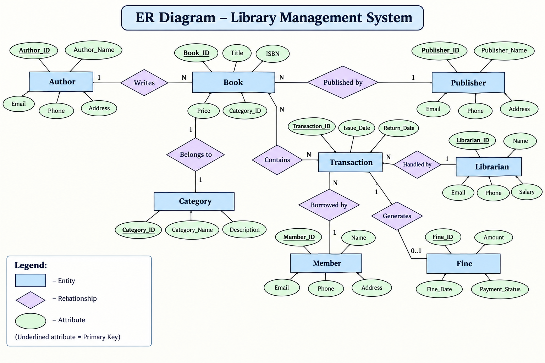

Slide 9
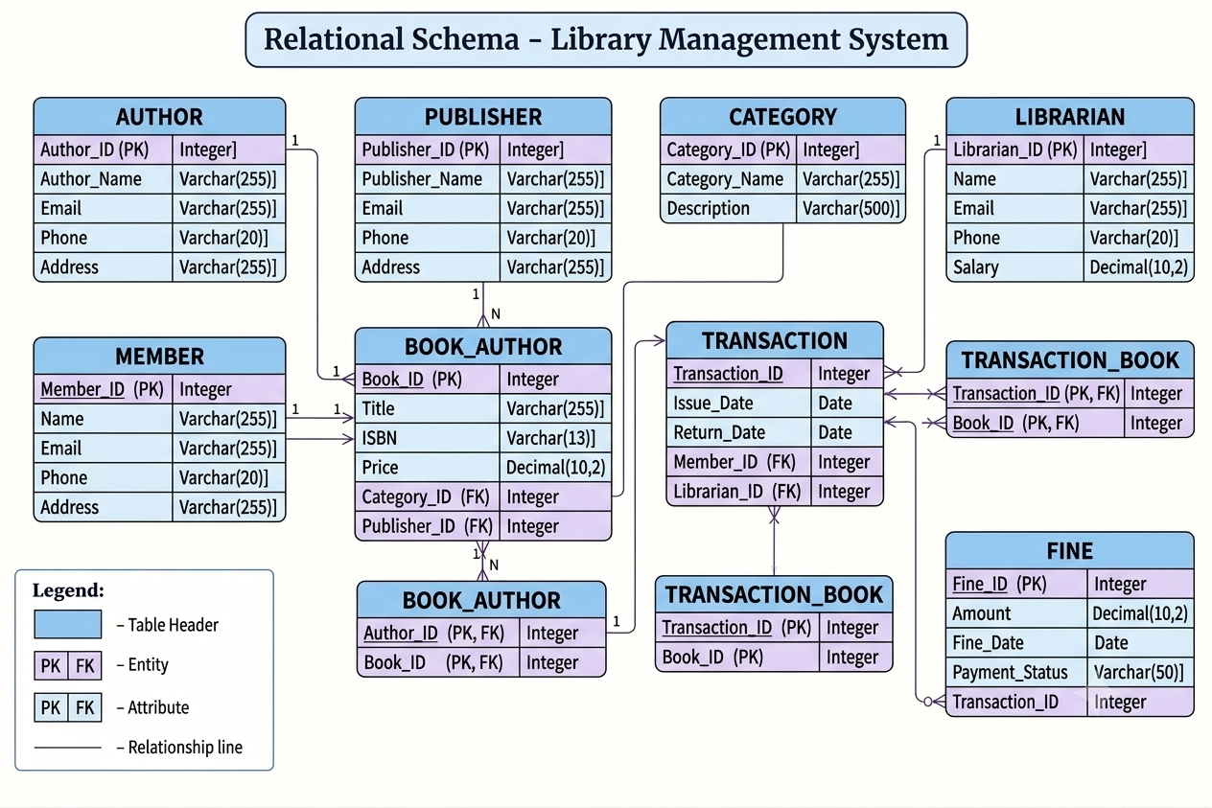

Slide 10
Primary & Foreign Keys
Entity | Primary Key (PK) | Foreign Keys (FK)
Book | Book_ID | Category_ID, Publisher_ID
Author | Author_ID | None
Category | Category_ID | None
Member | Member_ID | None
Transaction | Transaction_ID | Member_ID, Librarian_ID
Fine | Fine_ID | Transaction_ID
Writes (Junction) | (Book_ID, Author_ID) | Book_ID, Author_ID

Slide 11
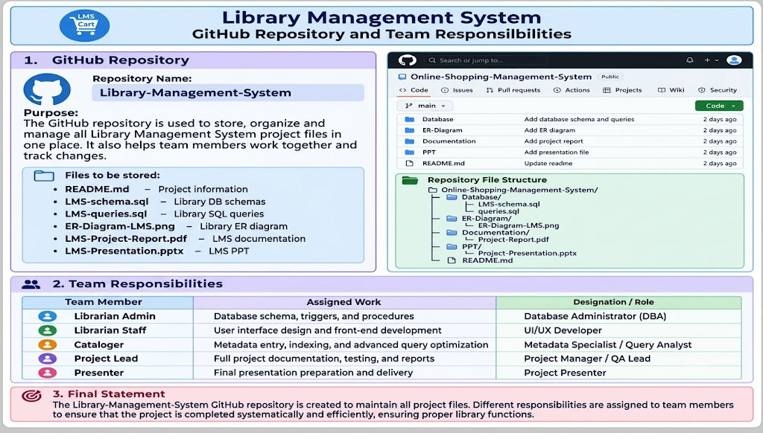
Library management system

Slide 12
DATABASE&CONSTRAINTS:
- Create DatabaseCREATE DATABASE LibraryManagementDB;USE LibraryManagementDB;
1. Category TableCREATE TABLE Category ( Category_ID INT PRIMARY KEY AUTO_INCREMENT, Category_Name VARCHAR(100) NOT NULL UNIQUE, Description TEXT
);
2. Publisher TableCREATE TABLE Publisher ( Publisher_ID INT PRIMARY KEY AUTO_INCREMENT, Publisher_Name VARCHAR(150) NOT NULL, Email VARCHAR(100) UNIQUE, Phone VARCHAR(20), Address TEXT
);
3. Author TableCREATE TABLE Author ( Author_ID INT PRIMARY KEY AUTO_INCREMENT, Author_Name VARCHAR(150) NOT NULL, Email VARCHAR(100) UNIQUE, Phone VARCHAR(20), Address TEXT
);

Slide 13
-- 4. Librarian TableCREATE TABLE Librarian ( Librarian_ID INT PRIMARY KEY AUTO_INCREMENT, Name VARCHAR(100) NOT NULL, Email VARCHAR(100) NOT NULL UNIQUE, Phone VARCHAR(20), Salary DECIMAL(10, 2) CHECK (Salary >= 0)
);
-- 5. Member TableCREATE TABLE Member ( Member_ID INT PRIMARY KEY AUTO_INCREMENT, Name VARCHAR(100) NOT NULL, Email VARCHAR(100) NOT NULL UNIQUE, Phone VARCHAR(20) NOT NULL, Address TEXT NOT NULL
);
-- 6. Book TableCREATE TABLE Book ( Book_ID INT PRIMARY KEY AUTO_INCREMENT, Title VARCHAR(255) NOT NULL, ISBN VARCHAR(13) NOT NULL UNIQUE, Price DECIMAL(10, 2) CHECK (Price >= 0), Category_ID INT NOT NULL, Publisher_ID INT NOT NULL, FOREIGN KEY (Category_ID) REFERENCES Category(Category_ID) ON DELETE CASCADE, FOREIGN KEY (Publisher_ID) REFERENCES Publisher(Publisher_ID) ON DELETE CASCADE
);

Slide 14
7. Writes Table (Junction Table for N:M Author-Book Relationship)CREATE TABLE Writes ( Book_ID INT, Author_ID INT, PRIMARY KEY (Book_ID, Author_ID), FOREIGN KEY (Book_ID) REFERENCES Book(Book_ID) ON DELETE CASCADE, FOREIGN KEY (Author_ID) REFERENCES Author(Author_ID) ON DELETE CASCADE
);
-- 8. Transaction TableCREATE TABLE Transaction ( Transaction_ID INT PRIMARY KEY AUTO_INCREMENT, Issue_Date DATE NOT NULL, Return_Date DATE, Member_ID INT NOT NULL, Librarian_ID INT NOT NULL, FOREIGN KEY (Member_ID) REFERENCES Member(Member_ID) ON DELETE CASCADE, FOREIGN KEY (Librarian_ID) REFERENCES Librarian(Librarian_ID) ON DELETE CASCADE, CONSTRAINT CHK_Dates CHECK (Return_Date IS NULL OR Return_Date >= Issue_Date)
);
-- 9. Transaction_Book Table (Junction Table for N:M Transaction-Book Relationship)CREATE TABLE Transaction_Book ( Transaction_ID INT, Book_ID INT, PRIMARY KEY (Transaction_ID, Book_ID), FOREIGN KEY (Transaction_ID) REFERENCES Transaction(Transaction_ID) ON DELETE CASCADE, FOREIGN KEY (Book_ID) REFERENCES Book(Book_ID) ON DELETE CASCADE
);
-- 10. Fine TableCREATE TABLE Fine ( Fine_ID INT PRIMARY KEY AUTO_INCREMENT, Amount DECIMAL(10, 2) NOT NULL CHECK (Amount >= 0), Fine_Date DATE NOT NULL, Payment_Status VARCHAR(20) DEFAULT 'Pending' CHECK (Payment_Status IN ('Pending', 'Paid', 'Waived')), Transaction_ID INT UNIQUE NOT NULL, FOREIGN KEY (Transaction_ID) REFERENCES Transaction(Transaction_ID) ON DELETE CASCADE
);

Slide 15
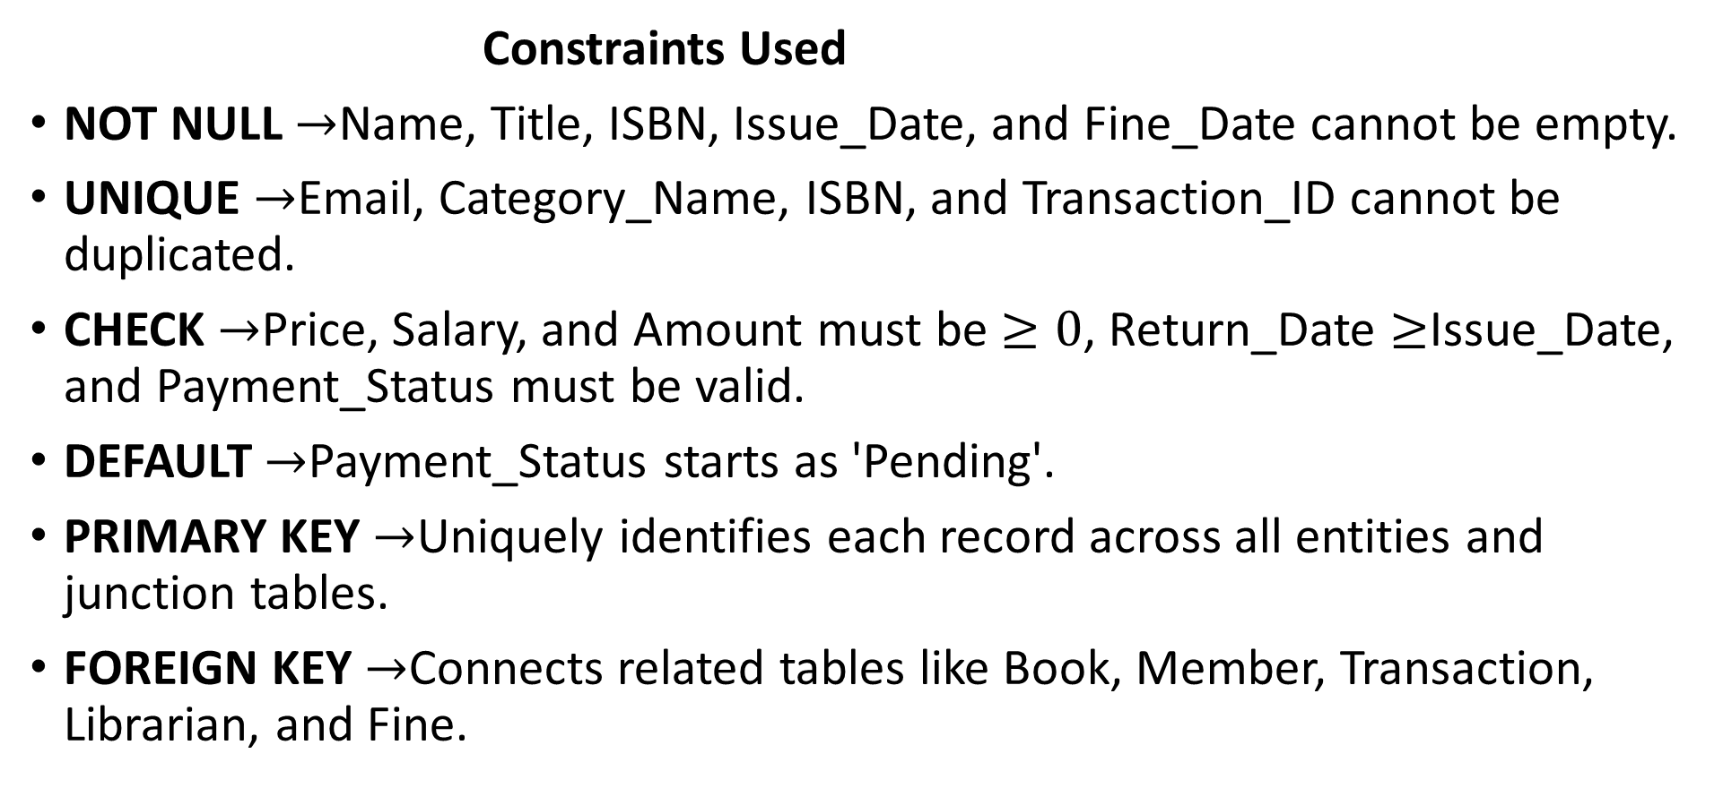
Constraints Used
NOT NULL $→$Name, Title, ISBN, Issue_Date, and Fine_Date cannot be empty.
UNIQUE $→$Email, Category_Name, ISBN, and Transaction_ID cannot be duplicated.
CHECK $→$Price, Salary, and Amount must be $≥0$, Return_Date $≥$Issue_Date, and Payment_Status must be valid.
DEFAULT $→$Payment_Status starts as 'Pending'.
PRIMARY KEY $→$Uniquely identifies each record across all entities and junction tables.
FOREIGN KEY $→$Connects related tables like Book, Member, Transaction, Librarian, and Fine.

Slide 16
SAMPLE DATA INSERTION:
INSERT INTO Category
*(Category_ID, Category_Name, Description)
VALUES
(1, 'Fiction', 'Fictional novels and literature’),
(2, 'Science', 'Scientific journals and textbooks’),
(3, 'Technology', 'Computer science and software engineering’);
INSERT INTO Publisher
(Publisher_ID, Publisher_Name, Email, Phone, Address)
VALUES* (1, 'Pearson Education', 'contact@pearson.com', '9876543220’,'Delhi’),
(2, 'Scribner', 'info@scribner.com', '9876543221', 'Mumbai’);
INSERT INTO Author
(Author_ID, Author_Name, Email, Phone, Address)

Slide 17
VALUES
(1, 'Abraham Silberschatz', 'silberschatz@gmail.com', '9876543230', 'Kolkata’),
(2, 'F. Scott Fitzgerald', 'fitzgerald@gmail.com', '9876543231', 'Delhi’);
INSERT INTO Librarian
(Librarian_ID, Name, Email, Phone, Salary)
VALUES
(1, 'Suresh Kumar', 'suresh@library.com', '9876543240', 45000.00),
(2, 'Anita Sharma', 'anita@library.com', '9876543241', 48000.00);
INSERT INTO Member

Slide 18
(Member_ID, Name, Email, Phone, Address)
VALUES
(1, ‘Rishi', ‘rishi@gmail.com', '9876543210', 'Hyderabad’),
(2, ‘Nandu', ‘nandu@gmail.com', '9876543211', 'Vijayawada’),
(3, 'Priya', 'priya@gmail.com', '9876543212', 'Chennai’),
(4, 'Kiran', 'kiran@gmail.com', '9876543213', 'Bangalore’);
INSERT INTO Book
(Book_ID, Title, ISBN, Price, Category_ID, Publisher_ID)
VALUES
(1, 'Database System Concepts', '9780073523323', 650.00, 3, 1),
(2, 'The Great Gatsby', '9780743273565', 350.00, 1, 2);

Slide 19
INSERT INTO Writes
(Book_ID, Author_ID)
VALUES
(1, 1),
(2, 2);
INSERT INTO Transaction
(Transaction_ID, Issue_Date, Return_Date, Member_ID, Librarian_ID)
VALUES
(1, '2026-09-01', '2026-09-15', 1, 1),
(2, '2026-09-05', NULL, 2, 2);
INSERT INTO Transaction_Book
(Transaction_ID, Book_ID)
VALUES
(1, 1),
(2, 2);

Slide 20
INSERT INTO Fine
(Fine_ID, Amount, Fine_Date, Payment_Status, Transaction_ID)
VALUES
(1, 50.00, '2026-09-16', 'Pending', 1);

Slide 21
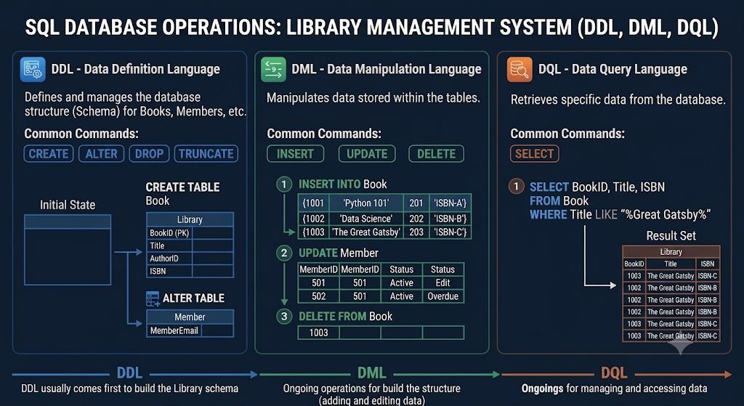
DDL,DML,DQL OPERATIONS:

Slide 22
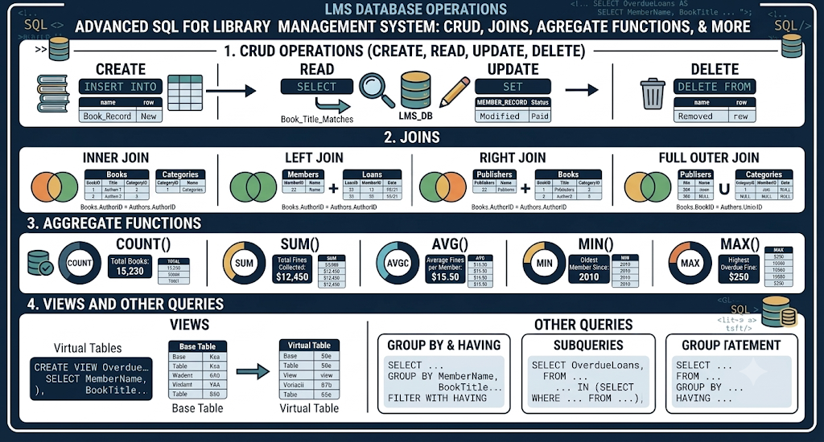
CRUD&SQL QUERIES:

Slide 23
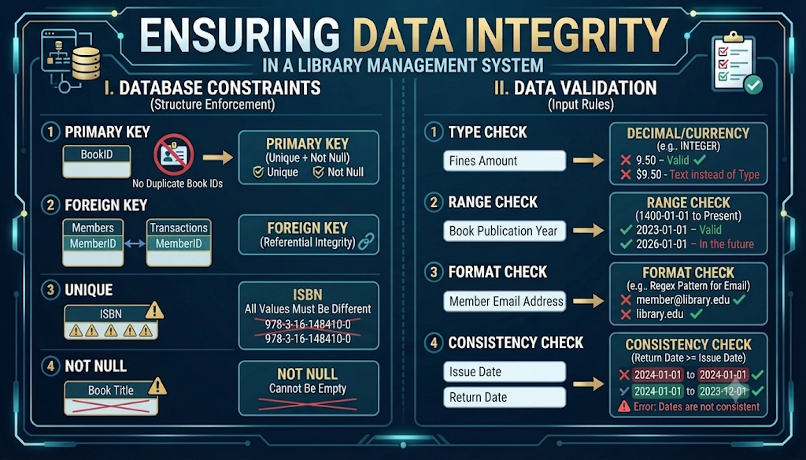
DATA INTEGRITY&VALIDATION:

Slide 24
PROJECT DOCUMENTATION:
Your LMS documentation is well-structured and technically sound up to Section 6. Here are the core strengths, quick fixes, and remaining sections needed to complete it.
Strengths
3NF Compliance: Normalization steps clearly justify eliminating redundancy across all 6 entities.
Proper Cardinality: Correctly models the many-to-many relationship between books and authors via Book_Authors.
Quick Fixes Needed
Align Member Attributes: Add the status column to Section 6.2 so it matches Section 6.5.
Add Bridge Table Attributes: Include Book_Authors in Section 6.2 using a composite primary key (book_id, author_id).
Handle Derived Fields: Plan to calculate available_copies, due_date, and fine_amount dynamically in SQL using triggers or views rather than storing raw values.
Next Steps to Complete Section 7 Onward
7.1 DDL Script: Write standard CREATE TABLE statements with primary keys, foreign keys, and CHECK constraints.
7.2 & 7.3 DML & Integrity: Insert sample data and list validation rules used to enforce referential integrity.
7.4 SQL Queries: Write 4–5 core queries covering multi-table JOIN operations, aggregate counts, and active loan views.
8 Modules: Create a short summary table mapping cataloging, circulation, and fine processing functions.
9–12 Wrap-Up: Fill in team responsibilities, future improvements (e.g., role-based access control), and the project conclusion

Slide 25
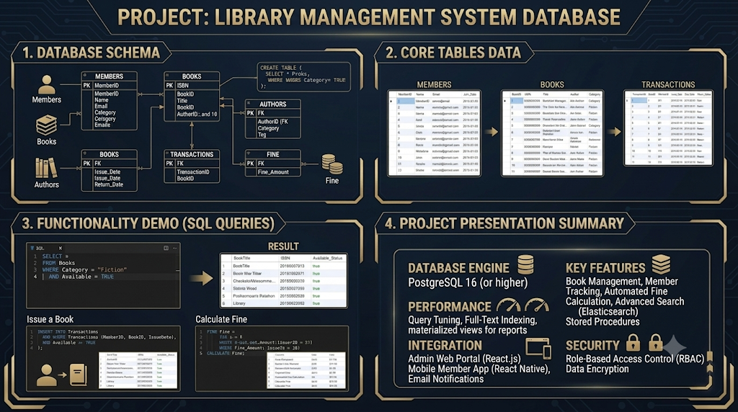
DEMONSTRATE&PRESENT:

Slide 26
CONCLUSION:
Database Design: Built using interconnected tables (Members, Books, Transactions, Authors, Categories) with strict PRIMARY KEY, FOREIGN KEY, and validation checks to prevent duplicate IDs.
Implementation: Utilized DDL, DML, DQL, advanced joins, aggregate functions, views, and PostgreSQL with ACID compliance.
Key Learnings: Learned the importance of relational constraints, query optimization, automated fine management, and clean data integrity rules.
Future Enhancements: Plans to add automated book reservation alerts, a Redis caching layer, and real-time overdue analytics dashboards.

Slide 27
THANK YOU

